Slide 1

Case Study: Spoofing Attack on Autonomous Vehicles.
Shihab Ud Doula | Matriculation No. 2190679.
Advisor: Prof. Dr.-Ing. João Paulo Javidi da Costa
Notes:
Good morning everyone. Today, I’ll be presenting my case study on 'Spoofing Attacks on Autonomous Vehicles.' This work explores the vulnerabilities of autonomous systems to spoofing attacks and the potential implications. I’m Shihab Ud Doula, and my advisor for this project is Prof. Dr.-Ing. João Paulo Javidi da Costa. Let’s dive in.

Slide 2
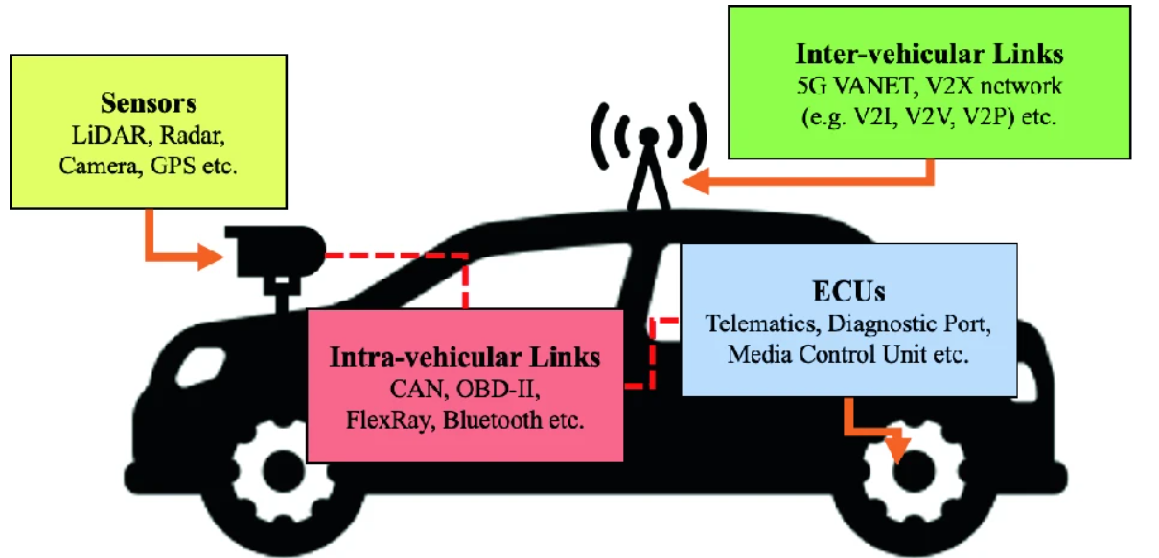
Understanding Spoofing in Autonomous Vehicles
Background: Autonomous vehicles (AVs) rely on GPS, time synchronization, and sensors for safe navigation. However, these dependencies make them vulnerable to spoofing attacks.
Problem Statement: Spoofing attacks can misguide navigation, disrupt system synchronization, and falsify environmental data, posing significant risks to safety.
Objectives:
Simulate spoofing attacks (GPS, time, and LiDAR)
Assess their impacts.
Propose mitigation strategies.
Notes:
Autonomous vehicles rely heavily on GPS, precise time synchronization, and sensor data for safe and accurate navigation. These dependencies, however, make them vulnerable to spoofing attacks. Spoofing attacks can misguide navigation, disrupt synchronization, and provide false environmental data, posing severe risks to safety. In this study, I aim to simulate these attacks, assess their impacts, and explore possible mitigation strategies

Slide 3
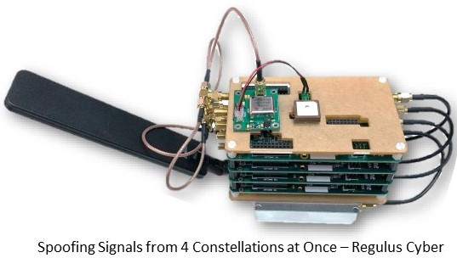
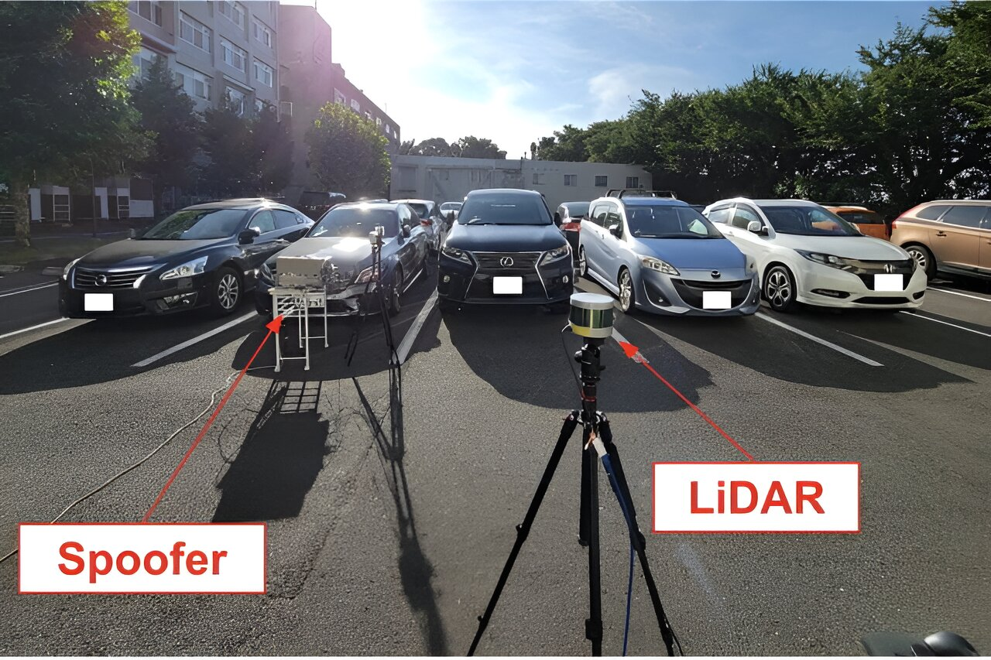
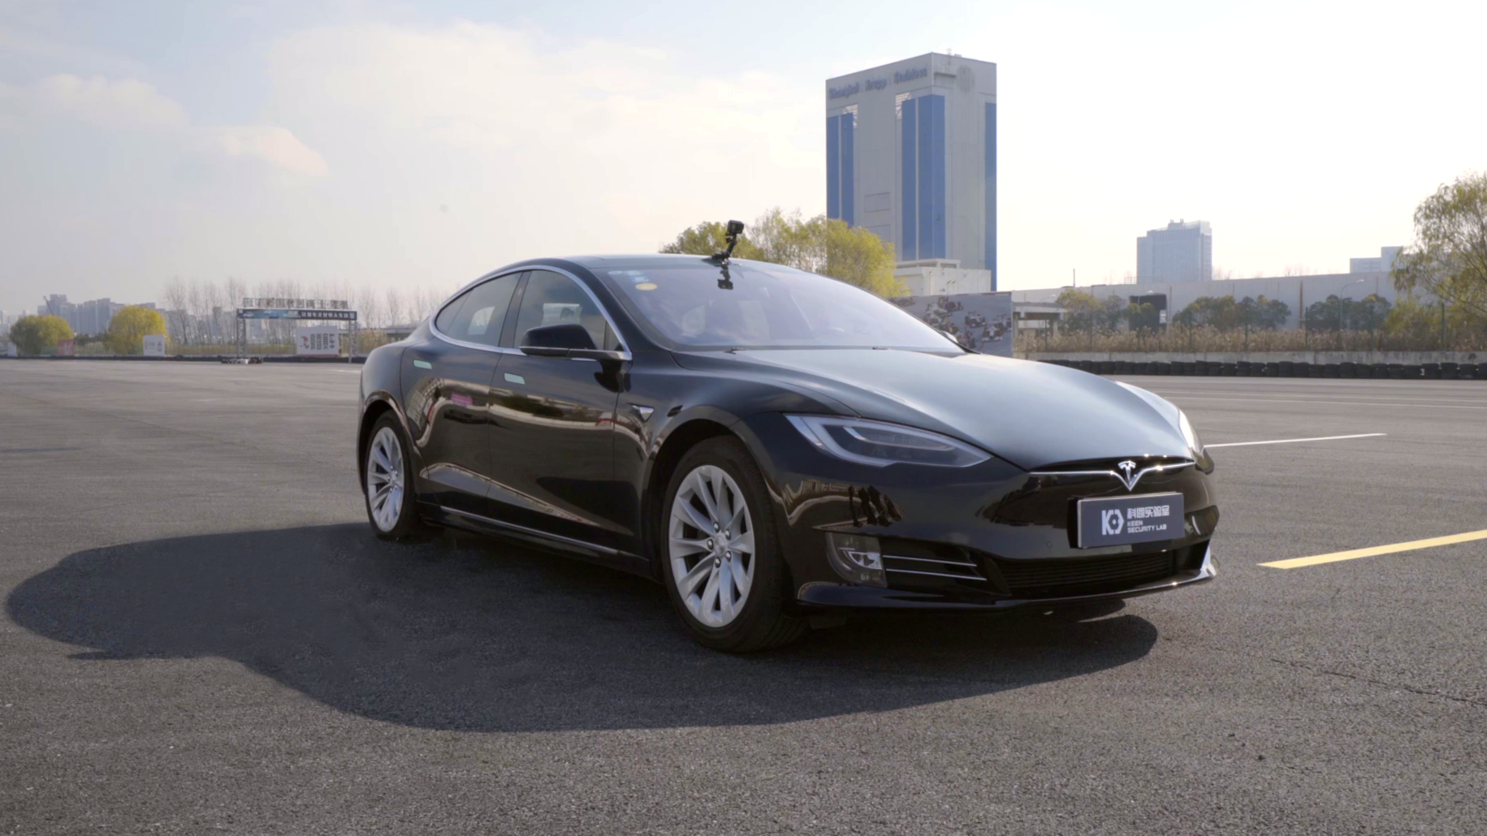
Research on Spoofing Attacks
GPS Spoofing (Regulus Cyber, 2019): Misguided navigation with fake GPS signals.
Time Spoofing (Keen Security Lab, 2019): System desynchronization causing critical errors.
LiDAR Spoofing (Cao et al., 2024): False obstacle detection via manipulated sensor inputs.
Notes:
Regulus Cyber's GPS Spoofing Attack on Tesla Model 3
Tools Used: Commercially available GNSS spoofing hardware and software.
Mechanism: Transmitted counterfeit GPS signals to mislead the vehicle's navigation system.
Outcome: The Tesla Model 3 miscalculated its location, decelerated unexpectedly, and attempted an incorrect highway exit, exposing the risk of GPS spoofing on autonomous vehicles.
Keen Security Lab's Time Spoofing Attack on Tesla Autopilot
Tools Used: Exploited software vulnerabilities and hardware interfaces.
Mechanism: Manipulated the internal clock of the vehicle, causing desynchronization between system components.
Outcome: The desynchronization disrupted the vehicle’s decision-making processes, leading to erratic behavior and highlighting the dangers of time spoofing.
3. Cao et al.'s LiDAR Spoofing Attack on Autonomous Vehicles
Tools Used: Laser-based spoofing techniques.
Mechanism: Injected fabricated laser signals into the LiDAR system to create false depth measurements and fake obstacles.
Outcome: The vehicle made incorrect driving decisions, such as braking or swerving unnecessarily, showcasing the risks of sensor spoofing attacks.

Slide 4

Simulation Design and Tools
Tools:
MATLAB Live Script: Interactive computation and visualization.
System: Windows 11, Intel i5, 16GB RAM.
Setup:
Simulation duration: 10 seconds with 1000 time points.
Initialization: Original signal defined as position (GPS), time (Time), or distance (LiDAR).
Spoofing start points: 20–30% of the timeline, depending on the simulation.
Notes:
For this study, MATLAB Live Script was utilized for its interactive computation and visualization features. The simulations were conducted on a Windows 11 system with an Intel i5 processor and 16GB of RAM. Each simulation spans 10 seconds and comprises 1000 time points. The spoofing attacks start at 20-30% of the timeline, depending on the type. Key parameters include signal amplitude, frequency variations, and noise for GPS, linear drift for time, and drift with sinusoidal noise for LiDAR.

Slide 5

Key Parameters:
GPS Spoofing:
Straight-line path with amplitude, frequency, and noise variations.
Time Spoofing:
Linear time signal with deviations
LiDAR Spoofing:
Constant distance of 20m with added linear drift and sinusoidal noise.

Slide 6
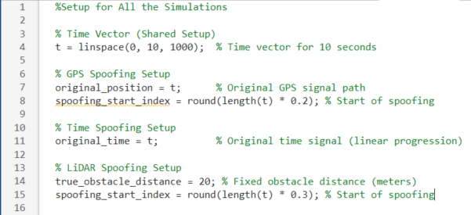
Code Setup for All simulation
Notes:
"All simulations share the same time vector and timeline setup. Spoofing starts between 20% and 30% of the timeline to mimic real-world attack scenarios.“ Explain Each Setup:
"In GPS spoofing, the original position follows a straight line. Spoofing introduces amplitude variations, frequency changes, and noise."
"For Time spoofing, we use a linear time signal and introduce deviations starting at 20%."
"LiDAR spoofing starts at 30%, adding linear drift and sinusoidal disturbances to the true obstacle distance.

Slide 7
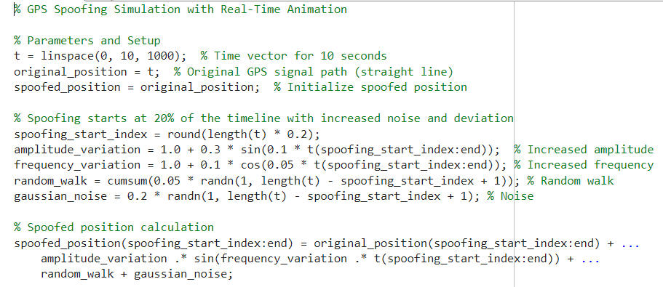
A GPS live script where parameter are defined

Slide 8
GPS Spoofing Simulation and Results
Overview:
Simulated GPS spoofing to observe its impact on position, velocity, and acceleration.
Spoofing starts at 2 seconds, introducing deviations through amplitude variations, frequency changes, random walk, and Gaussian noise.
Results highlight how spoofing disrupts the vehicle's navigation system by creating noticeable deviations in the trajectory.
Notes:
This slide demonstrates how GPS spoofing was simulated. The original path is a straight line, representing normal navigation. Spoofing starts at 20% of the timeline and introduces amplitude variations, frequency oscillations, random walk, and Gaussian noise to mimic real-world attack dynamics.

Slide 9
Key Components
Original Path: Straight-line trajectory (original_position = t).
Spoofing Elements:
Amplitude variation (1.0 + 0.3 * sin(0.1 * t)): Adds smooth oscillations.
Frequency variation (1.0 + 0.1 * cos(0.05 * t)): Adds periodic deviations.
Random walk (cumsum(0.05 * randn(...))): Introduces gradual drift.
Gaussian noise (0.2 * randn(...)): Simulates real-world randomness.
Analysed Metrics:
Position: Deviation of spoofed path from original.
Velocity and Acceleration: Effects on motion dynamics.

Slide 10
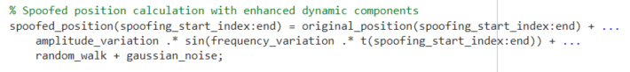
Main script for calculation
Key Logic for Spoofed Path Generation
Notes:
This snippet calculates the spoofed position by adding dynamic effects to the original GPS path. Specifically:""Amplitude and frequency variations simulate oscillations."
"Random walk introduces gradual drift over time."
"Gaussian noise mimics real-world signal randomness."

Slide 11
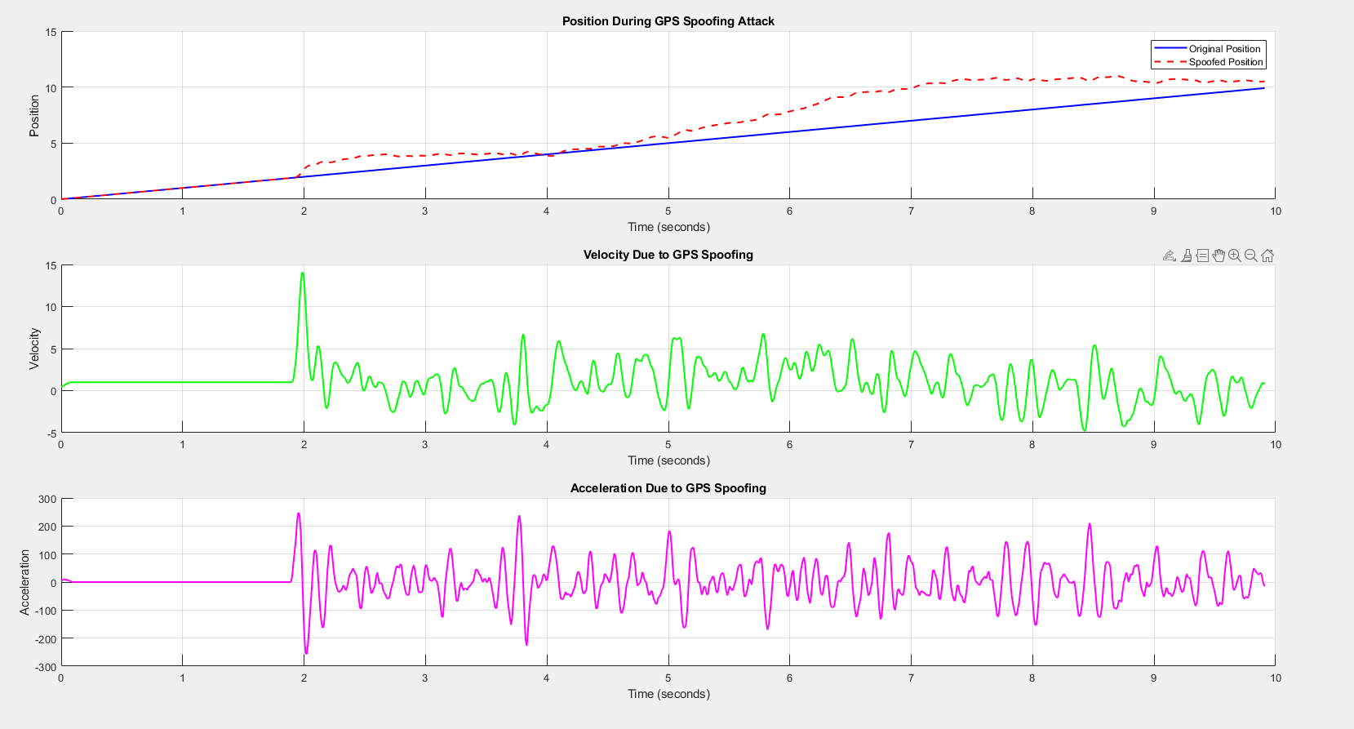
Results for GPS spoofing
Spoofing starts at 2 seconds
Peak deviation at 8 seconds
Velocity spikes after 2 seconds
Notes:
This graph shows the impact of GPS spoofing on position, velocity, and acceleration. In the first plot, we see the original straight-line path in blue, while the red dashed line shows the spoofed position. Spoofing starts at 2 seconds, and the deviation increases gradually, peaking at around 7 seconds with a displacement of 3.5 meters.
The second plot shows velocity, where we observe a sharp spike right after spoofing begins. This indicates that the spoofing not only affects the position but also causes instability in the motion.
Finally, the third plot shows acceleration, which reflects significant fluctuations after 2 seconds. These rapid changes highlight the abrupt and dynamic nature of the spoofing effects. Together, these plots demonstrate how spoofing disrupts the vehicle's navigation system."

Slide 12
Time Spoofing Simulation and Results
Overview:
Simulated time spoofing attack to observe its impact on GPS signals.
Spoofing starts at 20% of the timeline, introducing:
Linear drift: Mimics gradual timing errors.
Sinusoidal oscillations: Adds periodic disturbances.
Random noise: Simulates real-world signal disruptions.
Results highlight deviations in time signal, measurable offsets, and disturbances in signal stability.
Notes:
"This simulation models time spoofing, where deviations in the GPS time signal are introduced through drift, oscillations, and noise."

Slide 13
Spoofing elements:
Linear Drift: Gradual time shifts using:0.5 * (t - t_start)
Sinusoidal Disturbance: Periodic variations modeled as: 0.2 * sin(2 * pi * 0.5 * t)
Gaussian Noise: Adds random fluctuations using:0.1 * randn(...)

Slide 14
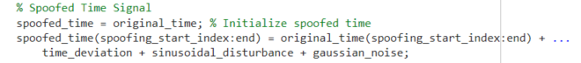
Main script for calculation
Demonstrates how drift, oscillations, and noise are combined to simulate the spoofed time signal.
Notes:
"This snippet calculates the spoofed time signal by adding a linear drift, sinusoidal oscillations, and random noise to the original signal."

Slide 15
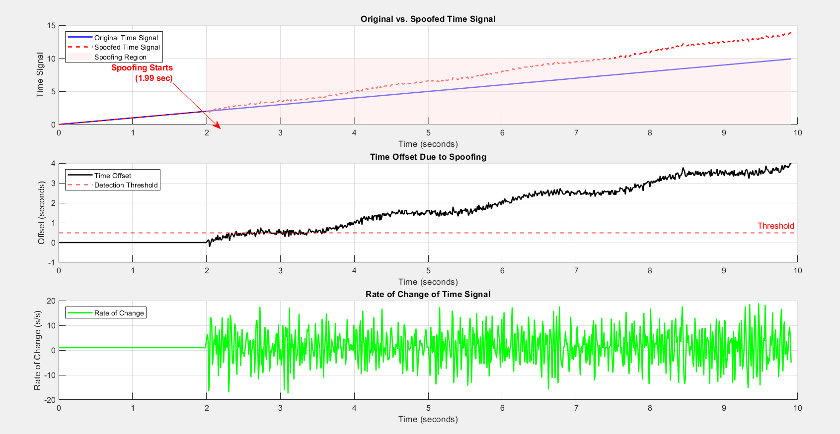
Results for time spoofing
Spoofing starts at 2 seconds, deviation increases
Offset crosses detection threshold at 3.7 seconds
spikes in the rate of change after spoofing starts.
Notes:
The top plot shows the spoofed signal deviating from the original after 2 seconds. The offset plot highlights measurable deviations exceeding the threshold at 6 seconds, which could disrupt navigation.""The rate of change plot shows spikes caused by spoofing, indicating how timing disturbances impact signal stability.“ Point to the top plot:"The top plot shows the spoofed time signal deviating from the original after 2 seconds. This deviation increases gradually over time."
Point to the middle plot:"The offset plot highlights a significant deviation, exceeding the detection threshold at 6 seconds."
Point to the bottom plot:"The rate of change plot captures the instability caused by spoofing, with visible spikes after spoofing starts."
This siulation showcases how time spoofing can disrupt navigation systems, emphasizing the importance of robust detection mechanisms.“ "The time offset measures how much the spoofed time signal deviates from the original. It's the difference between the correct time and the manipulated time introduced by the spoofing attack."
When Does It Cross the Threshold?
"In this simulation, the time offset crosses the detection threshold of 0.5 seconds shortly after spoofing starts, around 3–4 seconds. This highlights how quickly spoofing can cause significant deviations in timing."

Slide 16
Sensor Spoofing Simulation and Results
Overview:
Simulated sensor spoofing attack on LiDAR distance measurements to analyze its impact.
Spoofing begins at 30% of the timeline and ends at 60%, introducing:
Linear drift: Gradual increase in distance readings.
Sinusoidal disturbances: Mimics periodic fluctuations in distance.
Gaussian noise: Adds random variations to the data.
Results highlight deviations in measured distances and significant impacts on sensor accuracy.
Notes:
This simulation models sensor spoofing on LiDAR, where spoofed signals mimic false distance measurements through drift, oscillations, and noise."

Slide 17
Sensor Spoofing Elemets:
Linear Drift: Gradual shift using:0.5 * (t - t_start)
Sinusoidal Disturbance: Periodic fluctuations modeled as:2 * sin(2 * pi * 0.2 * t)
Gaussian Noise: Simulates randomness with:0.5 * randn(...)

Slide 18
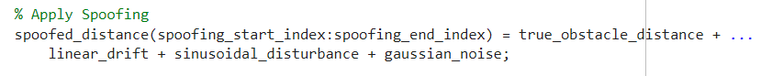
Main script for calculation
This code shows how the spoofing elements (drift, oscillations, noise) are combined to create a spoofed sensor reading.
Notes:
"This snippet computes the spoofed distance by combining three elements: linear drift for gradual shifts, sinusoidal disturbances for oscillations, and Gaussian noise for random variations."

Slide 19
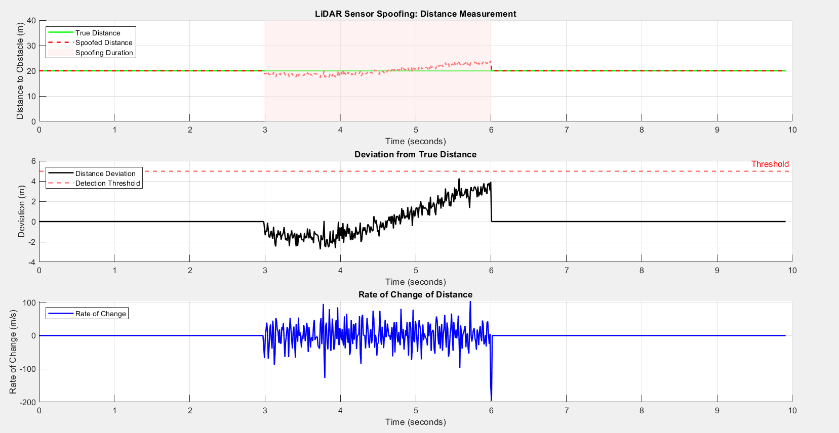
Results for sensor spoofing
Spoofing starts at 3 seconds and ends at 6 seconds.
Although this does not change major effect above the threshold.
Notes:
Discuss the Results:Point to the top plot:
"The top plot shows how spoofed distances deviate from the true distance, starting at 3 seconds and ending at 6 seconds."
Point to the middle plot:
"The deviation plot highlights significant errors, crossing the detection threshold after is down below thesholdseconds."
Point to the bottom plot:
"The rate of change plot shows spikes in activity, indicating abnormal sensor readings during the spoofing attack."
"The deviation from the true distance increases noticeably during the spoofing period, starting at 3 seconds and ending at 6 seconds. However, the deviation remains below the detection threshold, which suggests that the spoofing was subtle enough to avoid immediate detection."

Slide 20
Comparison of Spoofing Types
Process:
Simulated each spoofing type using unique dynamics.
Measured deviations, rate of change, and threshold crossing.
Metrics Evaluated:
Maximum Deviation (quantifies error severity).
Rate of Change (measures signal stability).
Threshold Crossing (detectability).
Spoofing Type | Max Deviation | Error Percentage | Noise Duration
GPS | 3.5 m | 35% | t =2 to 9 seconds
Time | 1.5 s | 15% | t =2 to 6 seconds
Sensor | 4 m | 20% | t =3 to 6 seconds
Notes:
The comparative analysis highlights the differences in how GPS, Time, and LiDAR spoofing affect the system.
Although LiDAR spoofing has the largest maximum deviation (4 meters), its error percentage is lower (20%) compared to GPS spoofing (35%). This is because the LiDAR spoofing noise occurs over a shorter duration (3 to 6 seconds), while GPS spoofing affects a longer time span (2 to 9 seconds), compounding the errors over time.
Time spoofing has the smallest maximum deviation (1.5 seconds) and error percentage (15%) since it primarily impacts the timing rather than the position directly.
In summary, the error percentage reflects the overall impact of spoofing, which depends on both the magnitude of deviation and the duration of the noise.
Example for Mathematical Calculations:
"For GPS spoofing, I calculated deviation as the absolute difference between true and spoofed positions: ErrorGPS=∣True Position−Spoofed Position∣\text{Error}_{GPS} = |\text{True Position} - \text{Spoofed Position}|ErrorGPS​=∣True Position−Spoofed Position∣. Similarly, for Time spoofing, I measured the time offset as OffsetTime=∣True Time−Spoofed Time∣\text{Offset}_{Time} = |\text{True Time} - \text{Spoofed Time}|OffsetTime​=∣True Time−Spoofed Time∣."

Slide 21
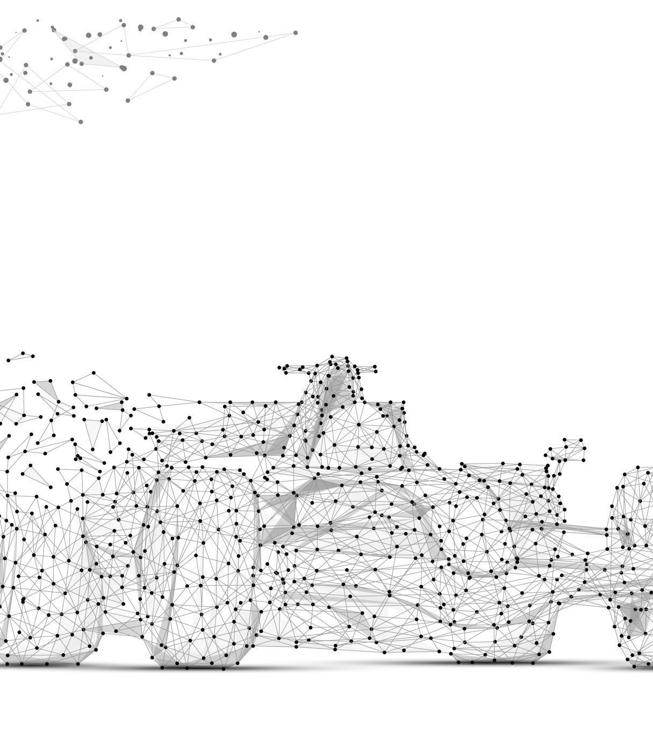
An Implementation of GPS Spoofing in Real World using API
Goal:
Simulate GPS spoofing effects on a vehicle’s movement.
Show incremental spoofing dynamics and their combined impact.

Slide 22
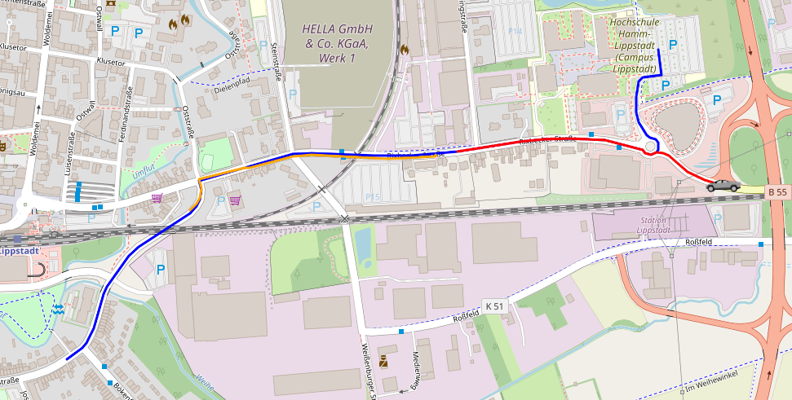
Incremental Effects: Oscillations, drift, noise (Orange line).
Major Spoof Event: Leads the car onto a wrong route (Red line)
Tesla Electric
Vehicle
Original Path: Blue line, fetched using ORS API.

Slide 23
Step-by-Step Process
1. Original Path (Blue Line):
Real GPS route from dorm to university (via ORS API).
2. Incremental Spoofing Dynamics (Orange Line):
Amplitude Variation: Small oscillations.
Frequency Variation: Varying motion.
Random Walk: Gradual drift.
Gaussian Noise: Random jitter.
3. Major Spoof Event (Red Line):
All dynamics combined at 50% of the route.
Redirects the car to a wrong route fetched using ORS.
Demo In Next Slide

Slide 24
Demo
file:///C:/Users/shiha/OneDrive/Desktop/11th%20semester/Final%20Project/Javascript%20Visualisation%20-%20Attempt%20with%20Matlab%20-.html
Notes:
This simulation demonstrates how GPS spoofing can alter a vehicle’s original route and lead it to a wrong destination. Let me explain step-by-step, including key technical details from the JavaScript code:
Setting Up the Map and Route: Using the OpenRouteService API, I fetched the original route from the dorm to the university. This route is visualized on the map as a blue line. The map is created using the Leaflet library, with the vehicle icon (car) starting at the dorm location.
Spoofing Dynamics Implementation: Spoofing starts after 20% of the route. To simulate this, I introduced four elements in the code:
Amplitude Variation: Applied smooth oscillations using a sine function (1.0 + 0.3 * sin(0.1 * t)).
Frequency Variation: Introduced periodic deviations using a cosine function (1.0 + 0.1 * cos(0.05 * t)).
Random Walk: Modeled cumulative sensor drift using a loop that calculates small random steps (cumsum(0.05 * randn())).
Gaussian Noise: Added small-scale randomness to simulate real-world GPS inaccuracies (0.2 * randn()).
These spoofing elements were applied step-by-step in the simulation to visualize their cumulative effects on the car’s position.
Dynamic Car Animation: The car’s movement is animated using a custom animateCar function. This function iterates through the coordinates of the original route, updating the car’s position on the map every second. Spoofing offsets are computed dynamically in the computeSpoofOffset function, which adjusts the car's latitude and longitude based on the spoofing dynamics.
Wrong Route Transition: At the midpoint of the spoofed journey, the car transitions onto a completely wrong route (red line). This wrong route is fetched separately from the API and is meant to show how spoofing can lead the vehicle far from its intended destination.
Annotations and Explanations: To make the simulation clear, the code uses map annotations to highlight when each spoofing element is applied. For example, when amplitude variation begins, an annotation pops up saying, "Amplitude Variation: Slight oscillations begin."
Final Outcome: The simulation ends with the vehicle reaching a wrong destination, demonstrating the critical risk of GPS spoofing in autonomous systems.
In conclusion, this simulation combines real-world API data, mathematical modeling, and dynamic visualization to illustrate the impacts of GPS spoofing on navigation.

Slide 25

Discussion and Insights
Findings:
GPS spoofing: Path deviations can misguide vehicles.
Time spoofing: Sync delays impact system reliability.
LiDAR spoofing: False readings compromise obstacle detection.
Challenges:
Balancing simplicity and realism in simulations.
Interpreting results in real-world contexts.

Slide 26

Conclusion and Future Work
Summary:
Spoofing attacks significantly disrupt AV safety and navigation.
GPS spoofing has the most direct impact on navigation.
Future Directions:
Real-world testing to validate findings.
Developing countermeasures for spoofing detection.
Exploring combined spoofing scenarios for deeper insights.

Slide 27
References
1. Cao, X., Chen, L., Zhao, Y., & Wang, J. (2023). *Temporal consistency checks to detect LiDAR spoofing attacks on autonomous vehicles*. Retrieved from [https://arxiv.org/pdf/2106.07833.pdf](https://arxiv.org/pdf/2106.07833.pdf)
2. Li, Z., Li, J., & Liu, X. (2023). *GPS-IDS: An anomaly-based GPS spoofing attack detection framework for autonomous vehicles*. Retrieved from [https://arxiv.org/pdf/2405.08359v1.pdf](https://arxiv.org/pdf/2405.08359v1.pdf)
3. Wang, T., Zhang, P., & Liu, Y. (2023). *Unveiling the stealthy threat: Analyzing slow drift GPS spoofing attacks on autonomous vehicles*. Retrieved from [https://arxiv.org/pdf/2401.01394.pdf](https://arxiv.org/pdf/2401.01394.pdf)
4. Zhou, H., Jiang, K., & Wu, Y. (2022). *Simulation of sensor spoofing attacks on unmanned aerial vehicles using ROS and Gazebo*. Retrieved from [https://arxiv.org/pdf/2309.09648.pdf](https://arxiv.org/pdf/2309.09648.pdf)
5. Khan, A., Ahmed, R., & Bashir, U. (2023). *LiDAR spoofing attack detection in autonomous vehicles*. Retrieved from [https://ieeexplore.ieee.org/document/9730540](https://ieeexplore.ieee.org/document/9730540)
6. Kim, Y., Chen, M., & Smith, J. (2023). *Adversarial sensor attack on LiDAR-based perception in autonomous driving*. Retrieved from [https://arxiv.org/abs/1907.06826](https://arxiv.org/abs/1907.06826)
7. Liu, H., Zhao, J., & Lin, S. (2023). *Anomaly detection against GPS spoofing attacks on connected and autonomous vehicles*. Retrieved from [https://ieeexplore.ieee.org/document/10109166](https://ieeexplore.ieee.org/document/10109166)
8. Regulus Cyber. (2021). *Case study: Tesla autopilot spoofing attack*. Retrieved from [https://www.regulus.com/case-study-tesla-spoofing-attack](https://www.regulus.com/case-study-tesla-spoofing-attack)
9. Keen Security Lab. (2022). *Case study: Time spoofing vulnerabilities in autonomous driving systems*. Retrieved from [https://keenlab.tencent.com/en/autonomous-time-spoofing-case-study](https://keenlab.tencent.com/en/autonomous-time-spoofing-casestudy)
10. Park, J., & Lee, K. (2022). *Securing autonomous vehicles against GPS spoofing attacks: A deep learning approach*. Retrieved from [https://ieeexplore.ieee.org/abstract/document/10264063](https://ieeexplore.ieee.org/abstract/document/10264063)

Slide 28

Questions?

